Slide 1

Auditory figure-ground segregation
in complex acoustic scenes
Sundeep Teki
Wellcome Trust Centre for Neuroimaging
University College London, UK

Slide 2
Outline
Figure-ground stimulus
fMRI study
Psychophysics
Modelling
MEG study
Depth electrode study?

Slide 3
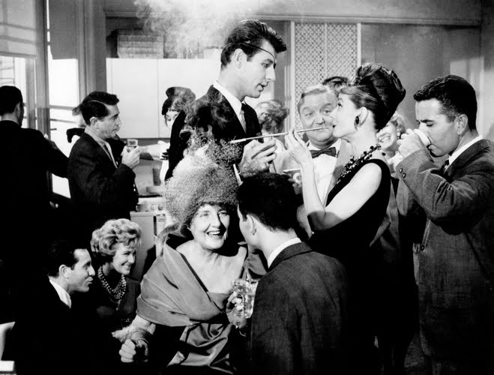
The problem

Slide 4
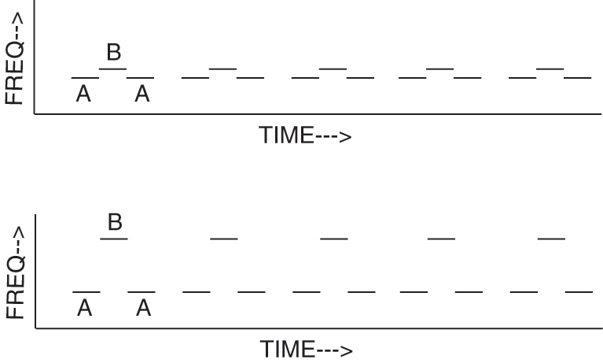
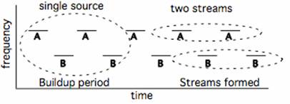
Stimuli

Slide 5

Stochastic Figure-Ground (SFG)

Slide 6
SFG: Figure present

Slide 7
SFG: Stimulus design
Stimulus:
Duration of each chord: 50 ms
Inter-chord interval: 0 ms
Total stimulus duration: 2000 ms (40 consecutive chords)
Chords:
No. of pure tone components: 5-15
Component frequency range: 179 – 7246 Hz
Resolution of frequency pool: 1/24th of an octave
Cosine ramp: 10 ms for onset and offset
Coherence:
Number of different repeating frequencies : 1, 2, 4, 6, 8
Duration:
Number of chords over which frequencies repeat : 2-7

Slide 8
Features of SFG
Figure and background signals do not differ in low-level acoustic attributes
No spectral ‘protective’ region between figure and background
Figure and background signals are indistinguishable at each point in time
Figure can only be extracted by integrating over time and frequency
Enables parametric variation of figure salience

Slide 9
Outline
Figure-ground stimulus
fMRI study
Psychophysics
Modelling
MEG study
Depth electrode study?

Slide 10
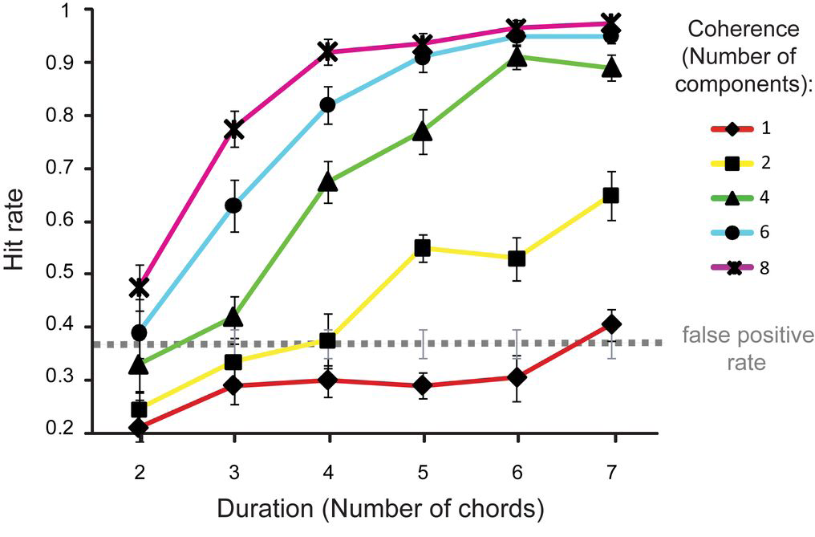
Behaviour
n=10
Listeners are remarkably sensitive to the appearance of figures
Sensitive to parametric variations of coherence and duration

Slide 11
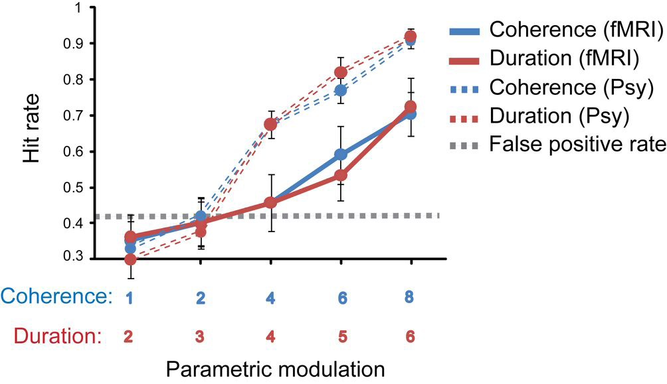
Behaviour in scanner

Slide 12

fMRI design
time
Figure (fixed coherence)
Background
ISI=mean 2 sec (jitter between 1.5-5) + 30% null events
Figure (fixed duration)
Decoy
Task: Detect decoy stimuli (noise bursts; 10% of stimuli)
Subjects were not actively detecting figures

Slide 13
fMRI analysis
14 subjects (normal hearing, no audiological disorders)
Standard pre-processing with SPM8
Whole brain analysis
Statistical model based on General Linear Model
Random effects design
Parametric Modulation:
I. Effect of Duration: Fixed coherence (4); varying duration (2-7)
II. Effect of Coherence: Fixed duration (4); varying coherence (1,2,4,6,8)
ISI=mean 2 sec (jitter between 1.5-5) + 30% null events

Slide 14
fMRI Results
I. Effects of Duration:
Intraparietal Sulcus (IPS) (bilateral; anterior)
Superior Temporal Sulcus (STS) (bilateral)
Planum Temporale (R)
Medial Geniculate Body (MGB) (bilateral)

Slide 15
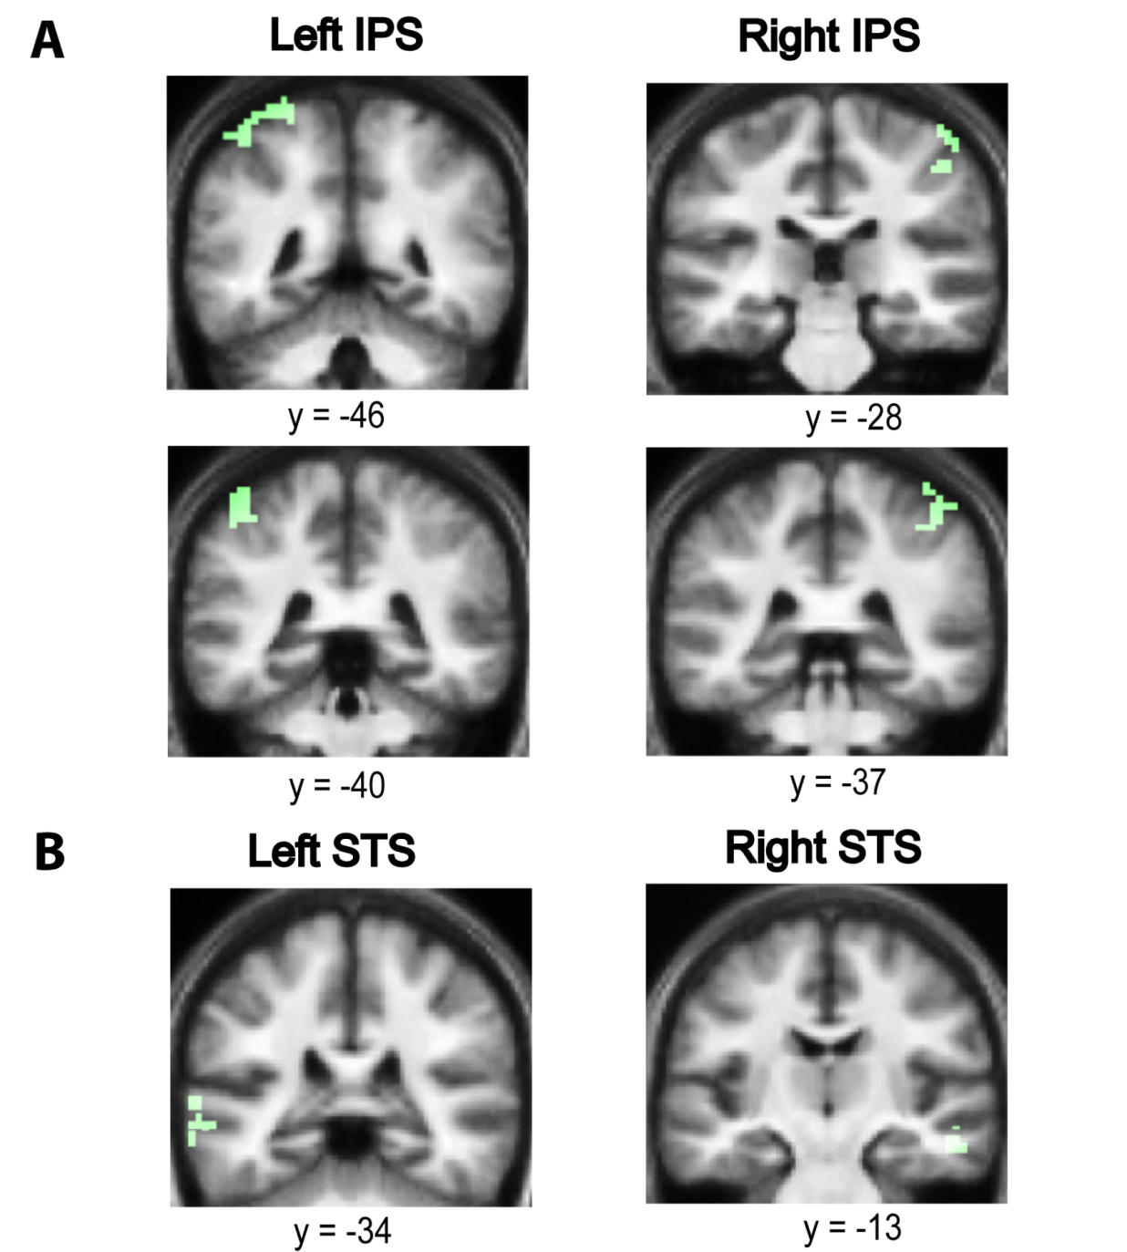
Effects of Duration

Slide 16
fMRI Results
II. Effects of Coherence:
Intraparietal Sulcus (bilateral; posterior)
Superior Temporal Sulcus (bilateral)

Slide 17
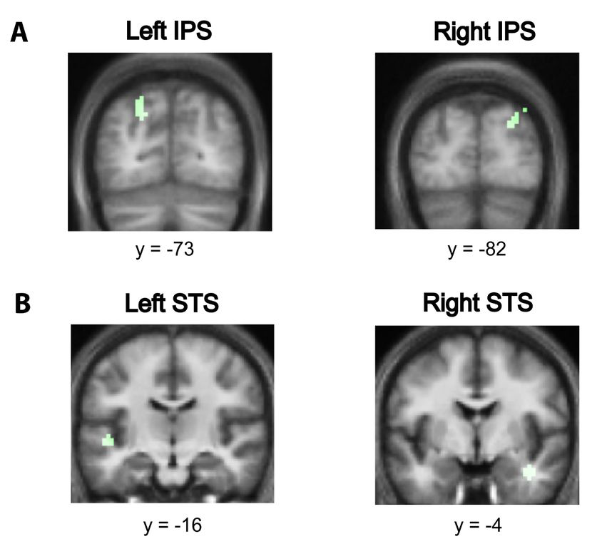
Effects of Coherence

Slide 18
What about the auditory cortex ?
No activation in Primary Auditory Cortex (PAC) for either contrast
Confirmed using volume of interest analysis based on PAC maps (Morosan et al., 01)
Consistent with one previous fMRI study (Cusack, 2005)
Reasons…
More complex and naturalistic stimulus
Naïve subjects and short figures
PAC recruited during active figure-ground segregation (i.e., in behavioural context)
with possibly top-down modulation by IPS?
Role of STS
STS activity modulated by changing duration and coherence of the figure
Implicated in:
- analysis of spectral shape (Warren et al., 2005)
- dynamic changes in spectrum (Overath et al., 2008)
- detection of changes in spectrotemporal coherence within textures
(Overath et al., 2010)

Slide 19
IPS and Perceptual Organization
Role of IPS consistent with Cusack (2005):
Implicated IPS in perception of two streams vs. one stream, based on the same
physical streaming signal that evoked a bistable percept.
IPS activity likely reflects top-down application of attention (shift between streams)
Found no activation in primary auditory cortex
IPS is involved in structuring sensory input and perceptual organization:
Encoding visual object representations
Binding of sensory features within and across different modalities
control and shift of auditory attention
What does the IPS activity reflect?
automatic, bottom-up segregation of auditory object from stochastic background

Slide 20
Outline
Figure-ground stimulus
fMRI study
Psychophysics
Modelling
MEG study
Depth electrode study?

Slide 21
Psychophysics
Aims:
To characterize the brain mechanisms that underlie complex figure-ground
segregation through systematic manipulations of the SFG stimulus
To examine sensitivity to figures by introducing systematic perturbations
Test role of adaptation in mediating segregation in our complex stimulus

Slide 22
Expt. 1: ‘Baseline’ (50 ms)
Coherence: [1 2 4 6 8] Duration: [2:7]

Slide 23
Expt. 1: Results
(n=9)

Slide 24
Psychophysics
Notes:
Adaptation within frequency bands

Slide 25
Psychophysics summary
Figure-detection performance in complex SFG stimulus is:
Depends on no. of repeating chords, not duration of figure (Expt. 1 & 2)
Invariant to disruption by white noise (Expt. 1 & 3)
Sensitive to shape of figure (continuous vs. ramped) (Expt. 1 & 4)
Sensitive to size of ramps (2 vs. 5) (Expt. 4a & 4b)
Invariant to the presence of preceding background (Expt. 1 & 5)

Slide 26
Outline
Figure-ground stimulus
fMRI study
Psychophysics
Modelling
MEG study
Depth electrode study?

Slide 27
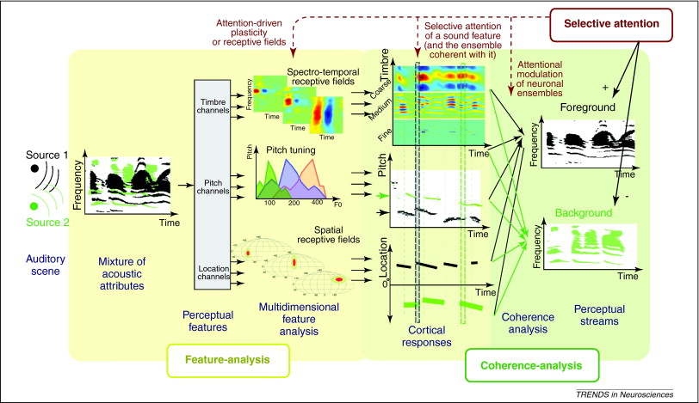
Temporal coherence model
(Chi et al., 2005; Elhilali et al., 2009; Shamma et al., 2011)

Slide 28
Temporal coherence model
STIMULUS
SPECTROGRAM
FEATURE
ANALYSIS
COHERENCE
ANALYSIS
DYNAMIC
COHERENCE
MATRIX
Chi et al., 2005; JASA
Elhilali and Shamma, 2008; JASA
Elhilali et al., 2009; Neuron
Shamma et al., 2011 TiNS

Slide 29
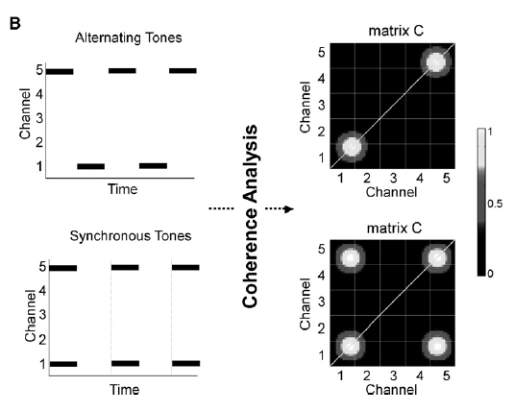
Temporal coherence & Streaming
Elhilali et al., 2009

Slide 30
Temporal coherence & SFG
Hypotheses:
Channels with repeating frequency components would be temporally coherent;
and these components may be grouped together and perceived as a single object.
Parameters of the model:
Temporal modulation: 20 Hz (tuned to chord repetition period of 50 ms)
Spectral resolution: 8 cyc/oct. (corresponding to BW in streaming)

Slide 31
Modelling expt 5 (‘isolated’)
I. Input: Different examples of figure and ground stimuli for each (coh, dur) x 1000

Slide 32
Coherence matrix
(figure present)
Coherence matrix
(figure absent)
Measure: 1st eigen value from PCA of coherence matrix

Slide 33
Output: 1st eigen value _{(figure)} - 1st eigen value_{(ground)}

Slide 34
Outline
Figure-ground stimulus
fMRI study
Psychophysics
Modelling
MEG study
Depth electrode study?

Slide 35
1. Basic
Figure onset

Slide 36
2. SFG + Noise
Teki, Chait et al., (in preparation)

Slide 37
Stimulus details
Frequency range: 170-2500 Hz
Conditions:
- no figure (50%)
- coherence 2 (16.67%)
- coherence 4 (16.67%)
- coherence 8 (16.67%)
100 trials/condition
Stimuli:
Basic SFG
Noise + SFG
X

Slide 38
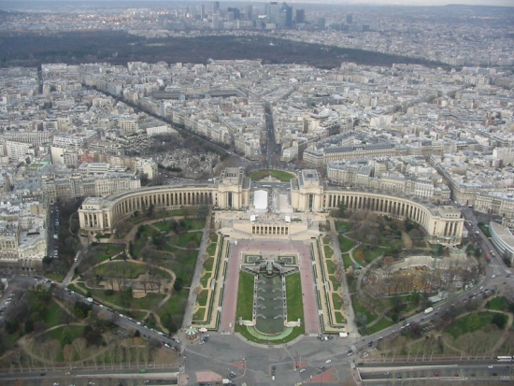


MEG Task
Subjects naïve to the auditory stimuli.
Performing an irrelevant visual task:
  -> Respond if image 3 is same as 1 or 2
1
2
3
time

Slide 39
Analysis
Evoked analysis (to examine temporal dynamics of the responses to the different figures)
Source localization using VB-ECD
Time-Frequency analysis to identify changes in brain rhythms following figure emergence
Induced response analysis using Quadratic Component Analysis (de Cheveigne, 2012; NeuroImage)

Slide 40
Hypotheses:
Evoked responses:
Early responses from auditory cortex reflect extraction of spectrotemporal regularities.
Later responses might involve effects mediated by IPS
Effects of noise? (latency scaled by 2?)
Induced responses:
Gamma correlate of figure-following response

Slide 41
Pilot data: Basic SFG
Coh 8
Coh 4
Coh 2
No figure

Slide 42
Outline
Figure-ground stimulus
fMRI study
Psychophysics
Modelling
MEG study
Depth electrode study?

Slide 43
Depth electrode study?
HYPOTHESES
Auditory cortex activity peaks early at transition and may not
be sensitive to the coherence of the figure
IPS/Parietal activity peaks later and shows sensitivity to the different coherence values of the figure
Abstraction of figure may be correlated with gamma
ANALYSIS
Evoked transition responses
Time-frequency: induced figure-following response
Temporal coherence modelling...

Slide 44
Summary
SFG stimulus:
Listeners can segregate figure from ongoing background very well.
fMRI:
Areas outside the auditory system, such as IPS are involved in segregation in
complex acoustic scenes
Psychophysics:
Adaptation is not critical for complex auditory segregation.
Temporal coherence model:
Can explain figure-ground segregation in complex acoustic scenes.
MEG:
Evaluate transitions from background to segments with different salience
Depth electrode recordings:
Look at source-space directly for transition and induced responses

Slide 45



Thanks to...
Deborah Williams
Sukhbinder Kumar,
Timothy D. Griffiths
Newcastle Auditory Group
Maria Chait
Aiysha Siddiq
Nicolas Barascud
UCL Ear Institute
Shihab Shamma
University of Marlyand, College Park

